Slide 1

Domain: MATLAB
Technology: Communication
An Efficient Resource Allocation Algorithm for D2D Communications Based on NOMA
<Name of the Students>

Slide 2
Index
Abstract
Introduction
Literature review
Existing Method
Drawbacks
Proposed method
Advantages
Applications
Hardware and Software Requirements
Results
Conclusion
References

Slide 3
Abstract:
A practically efficient resource allocation scheme is designed for multiple device-to-device cluster(D2DC) multicast communications. The transmit power and the channel are allocated to D2DC to maximize the sum effective throughput provided that the cellular communications maintain a certain level of quality of service. We devise a channel allocation scheme using partial information of device locations. For this, we derive the outage probability and an effective throughput of D2DC communications in approximate forms. This process is carried by increasing the cluster size, code words and subcarriers.

Slide 4
Introduction:
The recent unprecedented growth in the use of smart mobile devices and the increasing demand for a variety of multimedia applications in recent years, cellular networks are being greatly challenged. As one of the key technologies of the fifth-generation (5G) mobile communication Device-to-Device (D2D) communication enables direct communication between adjacent devices in the communication network without the support of infrastructure such as core equipment or central equipment so as to reduce the burden on the core network.
Non-Orthogonal Multiple Access (NOMA) allows multiple users to share the same resources in terms of time and frequency through power-domain multiplexing and serial interference cancellation (SIC) in order to improve the system throughput and energy efficiency [3]. Therefore, combining D2D with NOMA could greatly improve the quality of service of future mobile communication systems.

Slide 5
Literature Review:
S. No | Journal Type with year | Authors | Title | Outcomes
1 | IEEE Transactions on Wireless Communications, 2018 | Zhang, H.; Song, L.; Zhang, Y. J. | Load Balancing for 5G Ultra-Dense Networks Using Device-to-Device Communications. | Studied on device to device communications
2 | IEEE Communications Letters, 2018 | Pei, L.; Yang, Z.; Pan, C.; et al. | Energy-Efficient D2D Communications Under laying NOMA-Based Networks with Energy Harvesting. | Studied on D2D communications, and basics of NOMA.
3 | MDPI Symmetry Journal, 2018 | Liu, Y.; Qin, Z.; Elkashlan, M.; et al. | Non orthogonal Multiple Access for 5G | Differences between orthogonal and non orthogonal non orthogonal access

Slide 6
Literature Review:
S. No | Journal Type with year | Authors | Title | Outcomes
4 | MDPI Symmetry Journal, 2018 | Gazda, J.; Toth, P.; Zausinova, J.; et al. | On the Interdependence of the Financial Market and Open Access Spectrum Market in the 5G Network | Basics of the 5G systems
5 | MDPI Sensors Journal, 2019, 19(6), 1 18. | Rim, M and Go, E. | Relay Positions Considering Interference from other Sub-channels in OFDMA-Basetid D2D Group-Casng Systems. | Positions of the channel, sub carriers, D2D systems
6 | IEEE Systems Journal, 2017, 12(4), 3970 3984. | Ansari, R. I.; Chrysostomou, C.; Hassan, S.A.; et al. | 5G D2D Networks: Techniques, Challenges, and Future Prospects | D2D networks were studied for future prospects.

Slide 7
Existing Method:
An uplink transmit scenario in a single cell is considered, as shown in below Figure. The cell radius is represented by R, and the base station is located at the cell center. The cell comprises of 𝑁 number of D2D groups and 𝑀 number of cellular users. Each D2D group consists of one D2D transmitter and several D2D receivers where the receivers are randomly distributed. The devices are located within a circular area having a radius of 𝑑𝑚𝑎𝑥. It is assumed herein that through common control channel, the channel information of all users can be acquired via the base station while a channel allocation algorithm is performed at the base station to allocate channels for each user. The cellular user communicates with the base station in a traditional cellular mode and one channel is allocated to each cellular user.
The cellular users do not have interference since each channel is orthogonal to each other. Unlike the traditional D2D pair communication, the transmitters in each D2D group uses NOMA to transmit a super-imposed mixed signal including information required by multiple receiving ends, i.e., the required transmit power when NOMA is used. To facilitate the analysis without loss of generality, each D2D group is assumed to have two receiving ends.

Slide 8
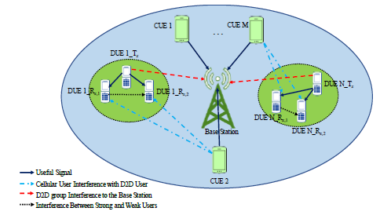
Proposed Method:
Block Diagram of D2D-NOMA system model.

Slide 9
Disadvantages
Computationally very expensive.
TTC (Total Time Consumption) strictly monotonically increases as transmission power decreases
Energy consumption is high in the number of multicast receivers.
No calculation of throughput

Slide 10
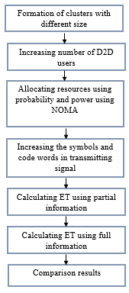
Proposed method

Slide 11
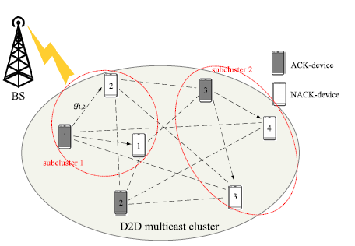
This work focuses on the reliable multicast of common data from BS in a cell of cellular network to N user devices which are close to one another, forming a D2D-MC, as shown
Figure 5. Example of D2D multicast cluster with ACK-devices/NACK-devices.

Slide 12
We consider the quasi-static fading channel where the random channel gain remains constant over the duration of multicasting one packet. Also, assume that BS has knowledge of the instantaneous channel power gains of all D2D links at the beginning of delivering one new packet. Here, we propose the following D2D communication based re-transmission way where all re-transmitters use a single channel rather than multiple channels based on the TDMA mode.
This is significant because the total channels available in WCN are quite limited. More specifically, BS first transmits (physical layer broadcasts) the packet to all devices in the D2D-MC and each device which correctly received the data from BS sends one ACK packet to BS.

Slide 13

In cellular mode the packets are first transmitted to base station by the file sharer and packets are then multi-casted to the group on DL. Actual data flows, retransmissions, or feedback is not modeled in these simulations. The same service (on UL and DL) is assumed for all the devices regardless of the communication mode. Only one hop communication is considered in the cluster.
Furthermore letrepresent the channel power gain of theD2D link from the ith ACK-device to the jth NACK-device. For the ithsubcluster, let girepresent the channel power gain of its worst D2D link, i.e.,

Slide 14


So the transmission rate of the ith ACK-device (theithsubcluster) can be expressed as
then the total time consumption (TTC) of all re-transmitters per packet delivery is

Slide 15
Applications of Proposed Method:
Automotive industry that leads the next generation of connected cars
Technology relays information such as the weather update
Coverage extension
Machine-to-machine (M2M) communication
Data and computation offloading

Slide 16
Hardware & Software Requirements:
Software: Matlab R2018a or above
Hardware:
Operating Systems:
• Windows 10
• Windows 7 Service Pack 1
• Windows Server 2019
• Windows Server 2016
Processors:
Minimum: Any Intel or AMD x86-64 processor
Recommended: Any Intel or AMD x86-64 processor with four logical cores and AVX2 instruction set support
Disk:
Minimum: 2.9 GB of HDD space for MATLAB only, 5-8 GB for a typical installation
Recommended: An SSD is recommended A full installation of all MathWorks products may take up to 29 GB of disk space
RAM:
Minimum: 4 GB
Recommended: 8 GB

Slide 17
References:
[1] Zhang, H.; Song, L.; Zhang, Y. J. Load Balancing for 5G Ultra-Dense Networks Using Device to-Device Communications. IEEE Transactions on Wireless Communications, 2018, 17(6), 4039 4050.
[2] Pei, L.; Yang, Z.; Pan, C.; et al. Energy-Efficient D2D Communications Under laying NOMA-Based Networks with Energy Harvesting. IEEE Communications Letters, 2018, 22(5), 914 917.
[3] Liu, Y.; Qin, Z.; Elkashlan, M.; et al. Non orthogonal Multiple Access for 5G and Beyond. Proceedings of the IEEE, 2017, 105(12), 2347 2381.

Slide 18
References:
[4] Gazda, J.; Toth, P.; Zausinova, J.; et al. On the Interdependence of the Financial Market and Open Access Spectrum Market in the 5G Network. MDPI Symmetry Journal, 2018, 10(1), 1 17.
[5] Rim, M and Go, E. Relay Positions Considering Interference from other Sub-channels in OFDMA-Based D2D Group-Casting Systems. MDPI Sensors Journal, 2019, 19(6), 1 18.
[6] Ansari, R. I.; Chrysostomou, C.; Hassan, S.A.; et al. 5G D2D Networks: Techniques, Challenges, and Future Prospects. IEEE Systems Journal, 2017, 12(4), 3970 3984.

